Slide 1
Web Scraping with Scrapy
Made by Anthony Edward, Raed Sherif.

Slide 2
TABLE OF CONTENTS
01
02
03
Planning & Analysis
The Scraping
Building the GUI

Slide 3
01
Planning & Analysis

Slide 4

Choosing A Website
Wuzzuf, A popular local job listing website in Egypt, to specifically scrape data about tech jobs and extract insights on the market.

Slide 5
We did this by turning off javascript from browser settings, navigated through the website to check for any data that is dynamically changing, we didn’t find anything that is javascript powered which made our job easier.
Choosing A Library
First, we understood the nature of the website to determine which library best suit our needs.

Slide 6



Libraries Comparison
We decided to move forward with Scrapy due to its ability of handling data with pipelines.
Beautiful Soup | Scrapy | Selenium
Best for Static Pages: Ideal for simple web scraping tasks. | High Performance: Designed for large-scale scraping with asynchronous request handling. | Handles JavaScript: Perfect for dynamic pages requiring interaction
Lightweight & Easy: Minimal setup and straightforward for beginners. | Built-In Features: Comes with pipelines, middlewares, and support for handling complex tasks like pagination. | Simulates Browser: Fully renders pages, making it slower but reliable for dynamic content.
Limitations: Doesn't handle JavaScript-rendered content | Steep Learning Curve: Requires more setup and familiarity with Scrapy framework. | Resource-Intensive: Heavier on memory and CPU compared to Scrapy or BeautifulSoup.

Slide 7


Collaboration with Github
For seamless cooperation we coded our project on Github and used Git for version control to be in full sync with each other.
github.com/RaedSherif/Web-Scraping

Slide 8
The Scraping
02
Deep dive into the steps and processes

Slide 9
Selecting Elements
We used CSS/XPATH selectors to tell the spider where to find the specific information we are looking for.
Examples of CSS Selectors:
Selector Type | Syntax Example | How it works
Class Selector | .class-name | Selects all elements with the class name
Direct Child | div > span | Selects all span elements that are direct children
Descendant Selector | div span | Selects all span elements are are descendants
Text Pseudo-element | ::text | Extract text content from element
Attribute Selector | attr(attribute-name) | Selects elements with a specific attribute value
Sibling Selector | div + span | Selects the next span sibling element

Slide 10
Data Items & Pipelines
Now in the data items we define the scraped item structure and process it in the pipeline for data cleaning and to store it in the database for further queries, analysis and extraction.

Slide 11
Storing in MySQL Database
We setup a pipeline to insert each item to our local database in MySQL.

Slide 12
03
Building The GUI
You can enter a subtitle here if you need it

Slide 13
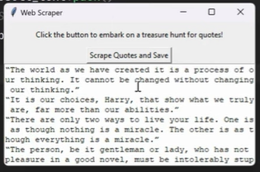
Learning how the GUI worked with the scraping mechanism

Slide 14
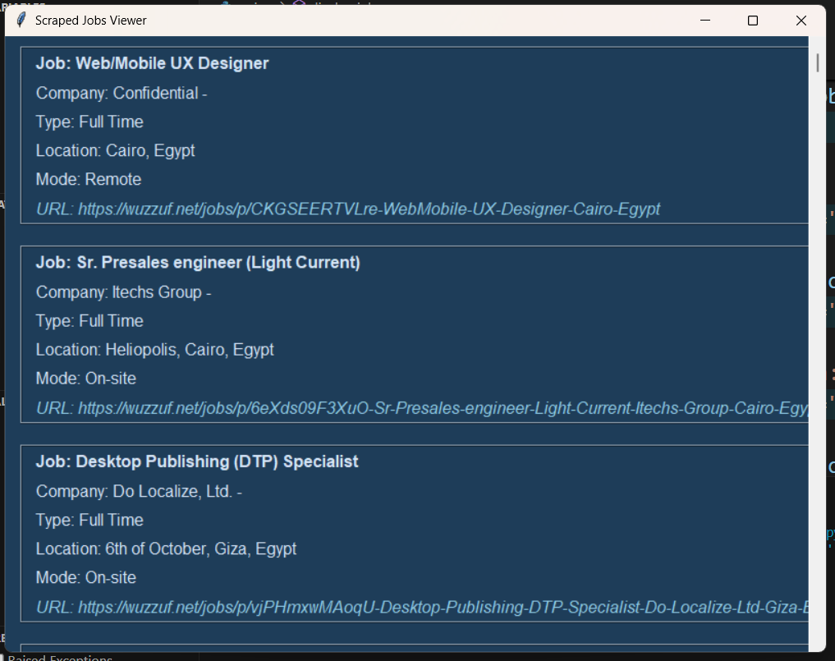
The GUI

Slide 15
THANKS!
If you have any questions please don’t ask!
Please keep this slide for attribution

